Slide 1

SQL TASK-2
OBJECTIVE
The CORONA VIRUS pandemic has had a significant impact on public health and has created an urgent need for data-driven insights to understand the spread of the virus.
Analyzing a CORONA VIRUS dataset to derive meaningful insights and present your findings.

Slide 2

Dataset:
Province: Geographic subdivision within a country/region.
Country/Region: Geographic entity where data is recorded.
Latitude: North-south position on Earth's surface.
Longitude: East-west position on Earth's surface.
Date: Recorded date of CORONA VIRUS data.
Confirmed: Number of diagnosed CORONA VIRUS cases.
Deaths: Number of CORONA VIRUS related deaths.
Recovered: Number of recovered CORONA VIRUS cases
TABLE NAME : Data

Slide 3
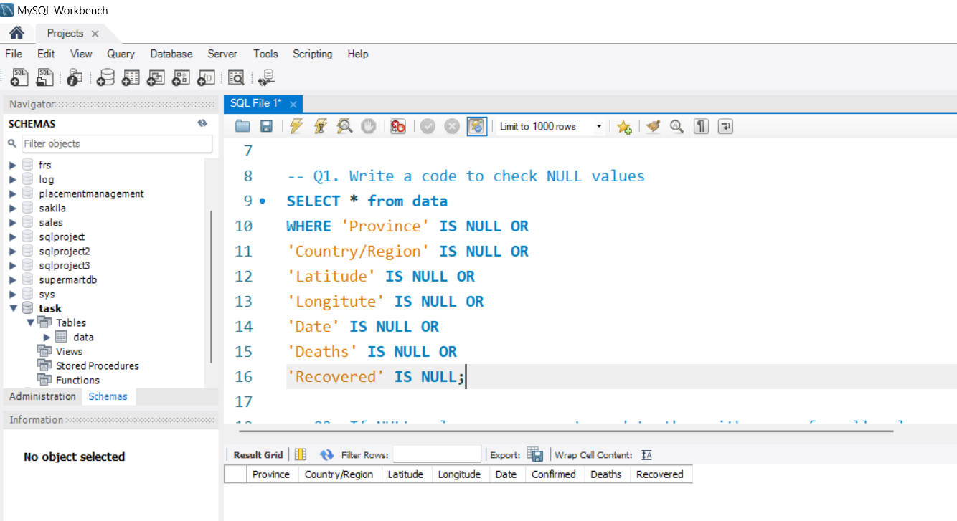
1. Write a code to check for null value
There are no null values
in the dataset so the result is null
The ISNULL() function returns a specified value if the expression is NULL. If the expression is NOT NULL, this function returns the expression.

Slide 4
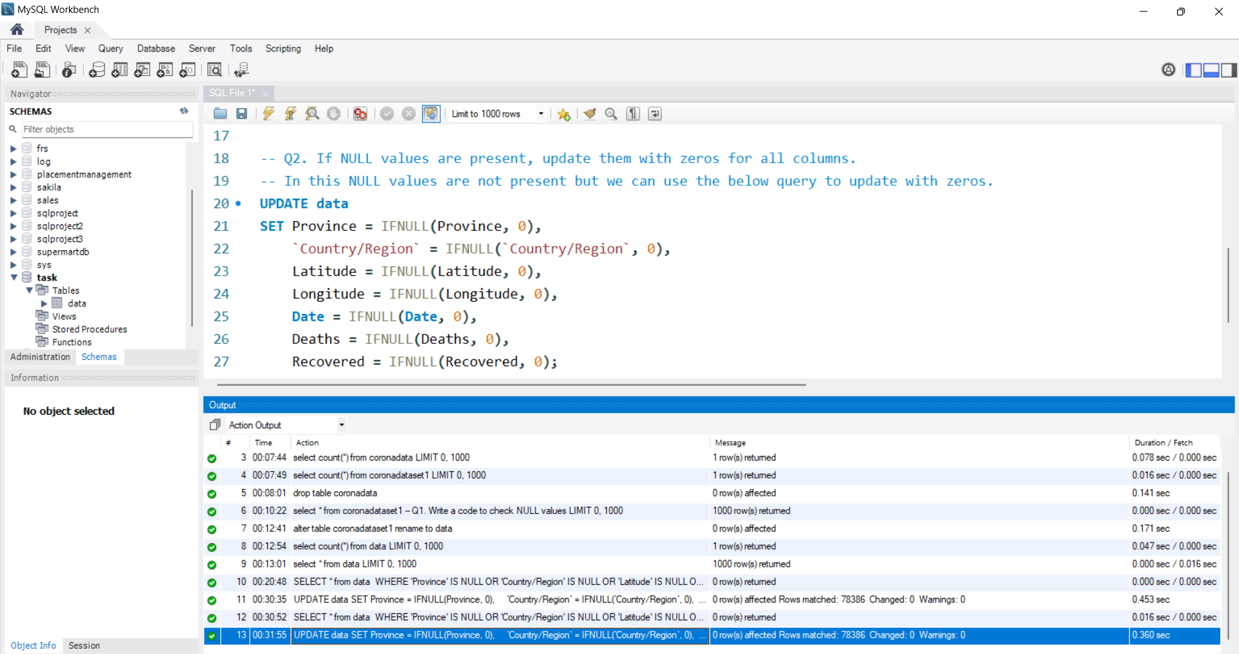
2. If NULL values are present, update them with zeros for all columns.
The IFNULL function takes two arguments. It checks to see if the first argument is not NULL.

Slide 5
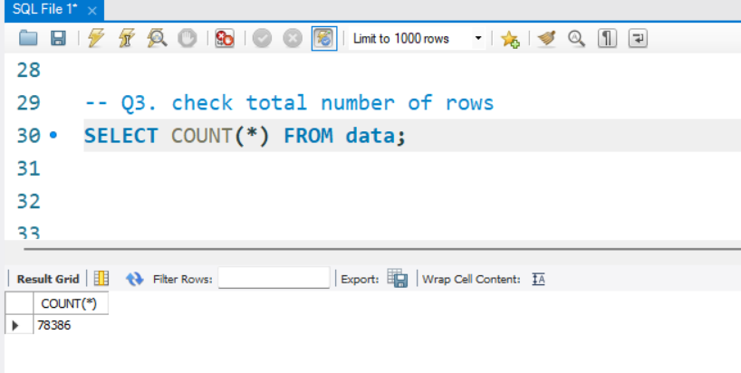
3. Check total number of rows
The COUNT() function returns the number of rows that matches a specified criterion.
ksjdgblsgd

Slide 6
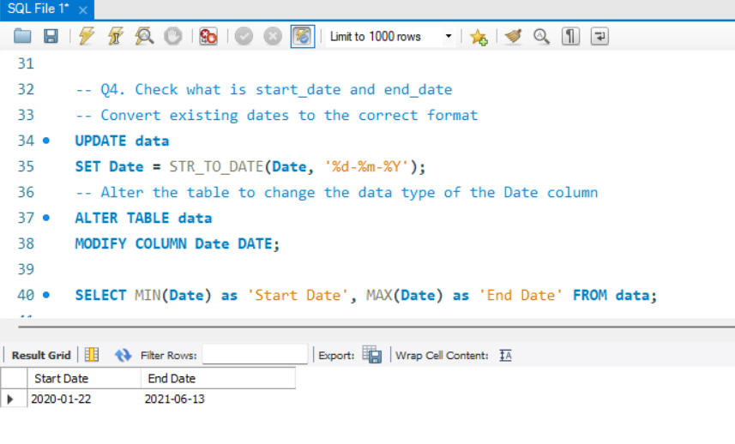
4. Check what is start_date and end_date
The MIN() function finds the smallest value in a set. In this case, it finds the earliest date in the Date column.
The MAX() function finds the largest value in a set. Here, it finds the latest date in the Date column.
AS 'Start Date' and AS 'End Date' alias the result columns as 'Start Date' and 'End Date' respectively for better readability.

Slide 7
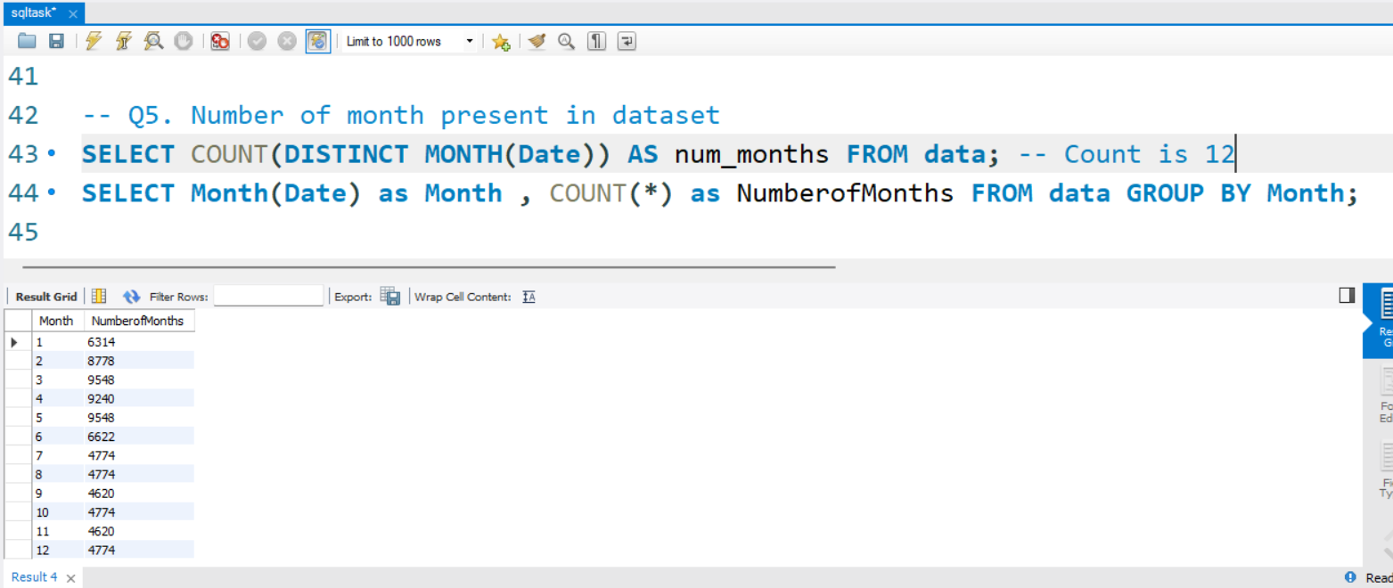
5. Number of month present in dataset
This query counts the number of occurrences of each month in the data table.
It extracts the month from the Date column and groups the results accordingly.

Slide 8
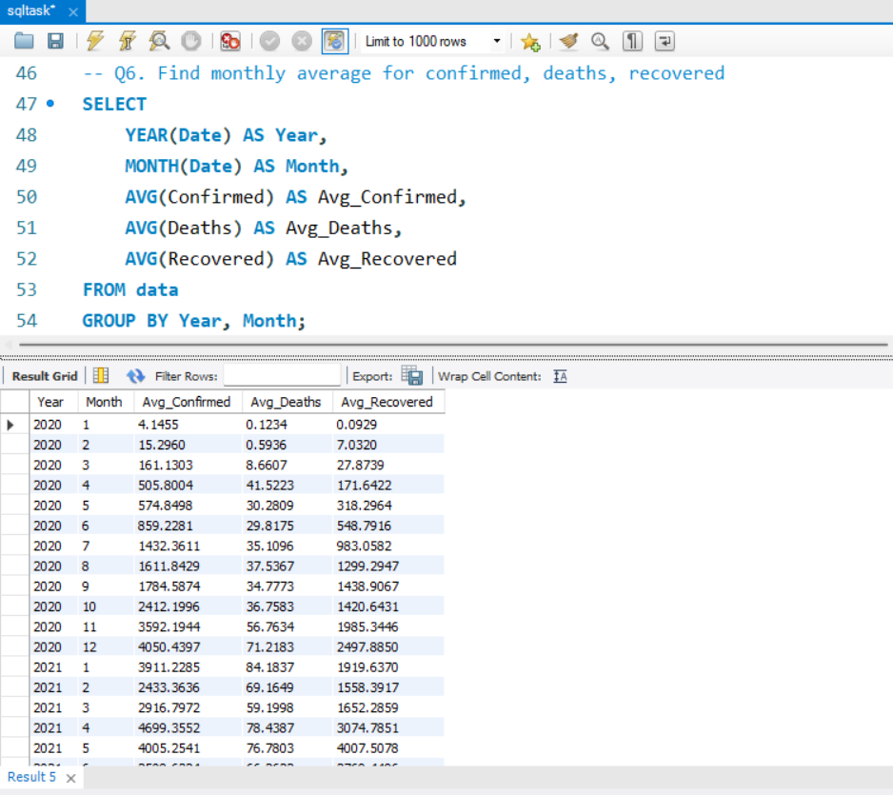
6. Find monthly average for confirmed, deaths, recovered

Slide 9
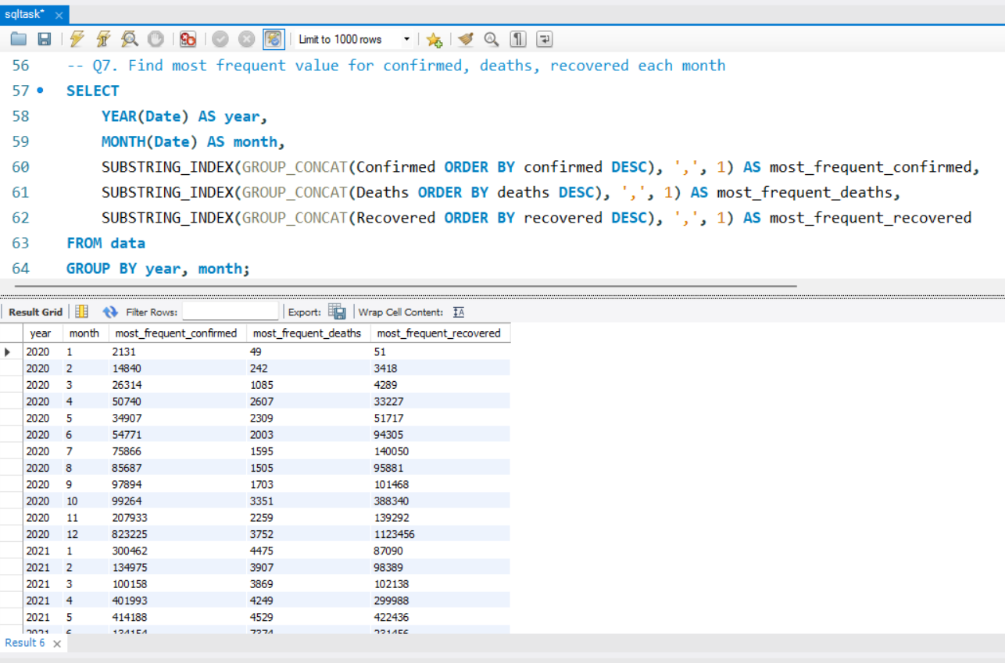
7. Find most frequent value for confirmed, deaths, recovered each month
ksjdgblsgd

Slide 10
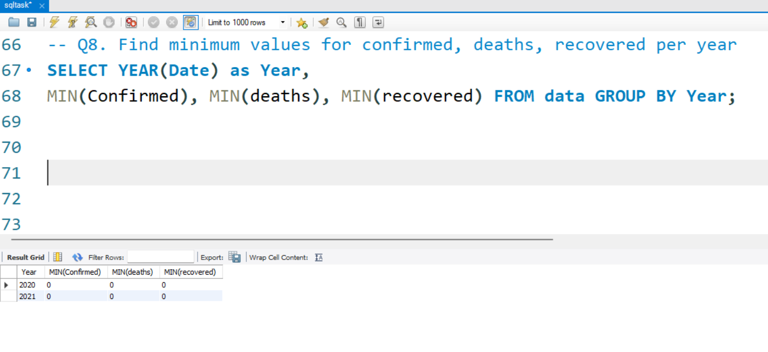
8. Find minimum values for confirmed, deaths, recovered per year
The MIN() function returns the smallest value of the selected column.
ksjdgblsgd

Slide 11
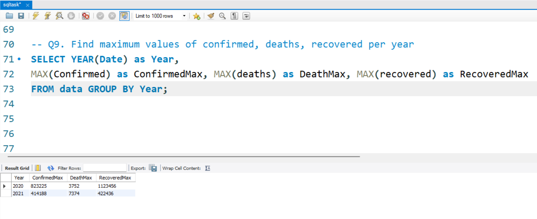
9. Find maximum values of confirmed, deaths, recovered per year
The MAX function in SQL is designed to identify the maximum value of a specified column. This function is particularly useful in retrieving the highest value from sets of data.
ksjdgblsgd

Slide 12
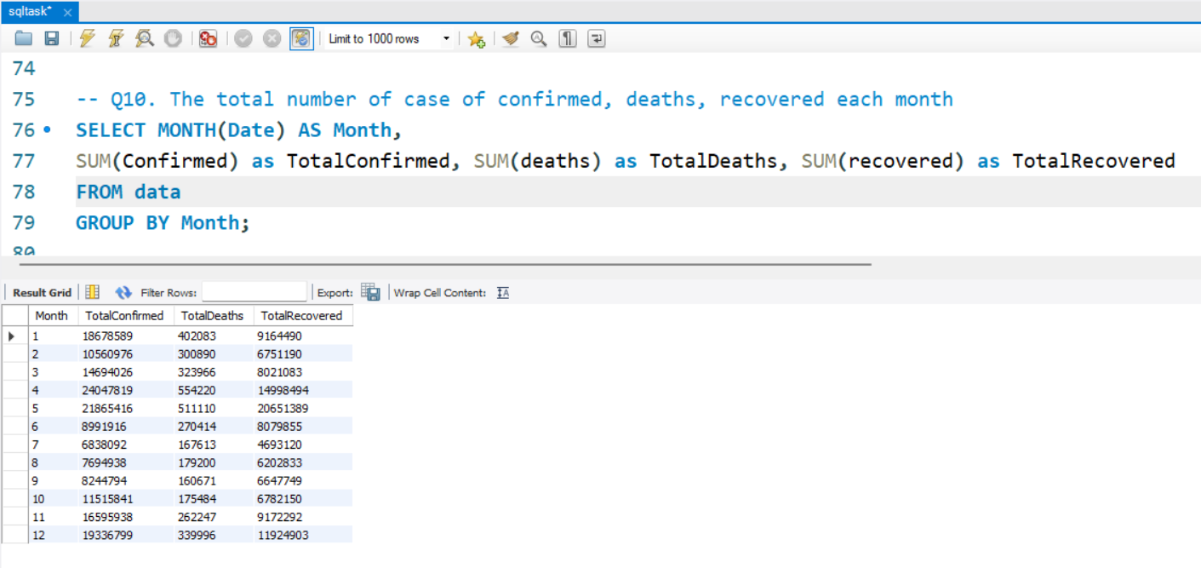
10. The total number of case of confirmed, deaths, recovered each month
The SUM() function returns the total sum of a numeric column.
ksjdgblsgd

Slide 13
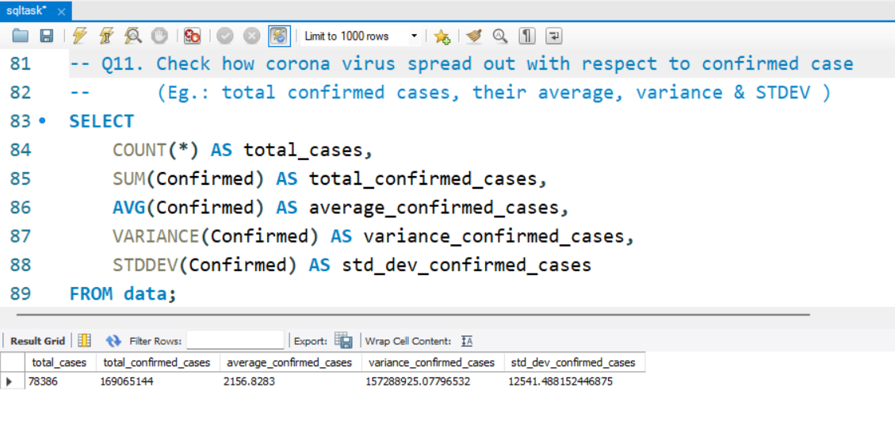
11. Check how corona virus spread out with respect to confirmed case
(Eg.: total confirmed cases, their average, variance & STDEV )
AVG(): Computes the average (mean) value of a numeric column.
VARIANCE(): Calculates the statistical variance of a numeric column.
STDDEV(): Computes the standard deviation of a numeric column.
ksjdgblsgd

Slide 14
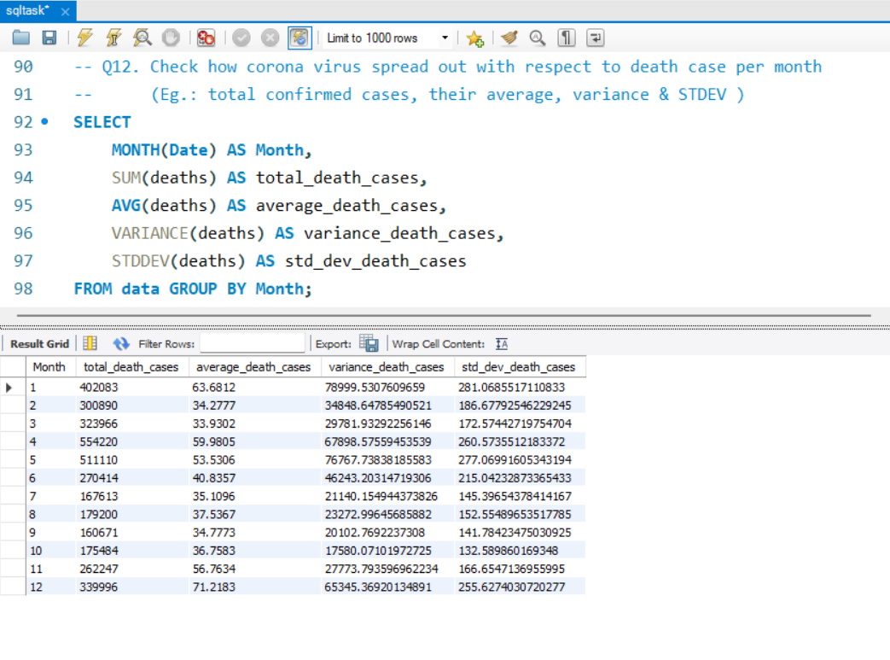
12. Check how corona virus spread out with respect to death case per month
(Eg.: total confirmed cases, their average, variance & STDEV )
ksjdgblsgd

Slide 15
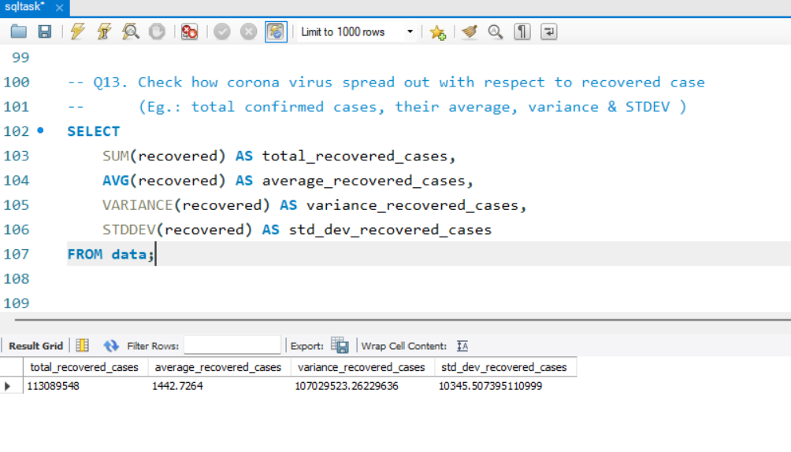
13. Check how corona virus spread out with respect to recovered case
(Eg.: total confirmed cases, their average, variance & STDEV )
ksjdgblsgd

Slide 16
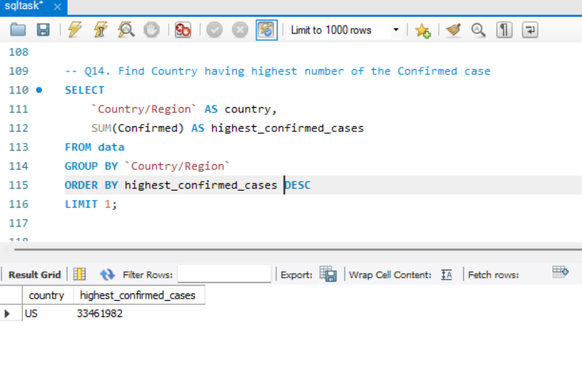
14. Find Country having highest number of the Confirmed case
ksjdgblsgd

Slide 17
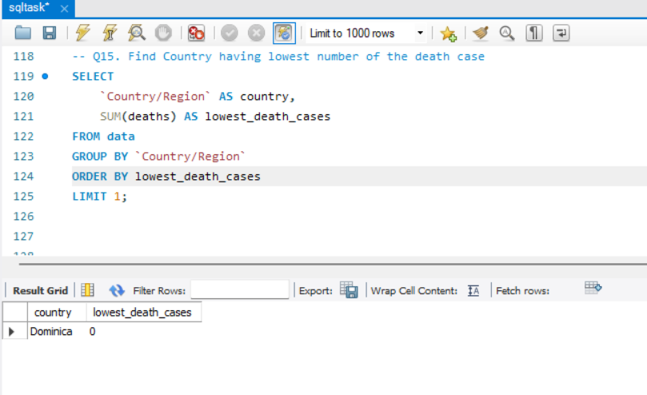
15. Find Country having lowest number of the death case
ksjdgblsgd

Slide 18
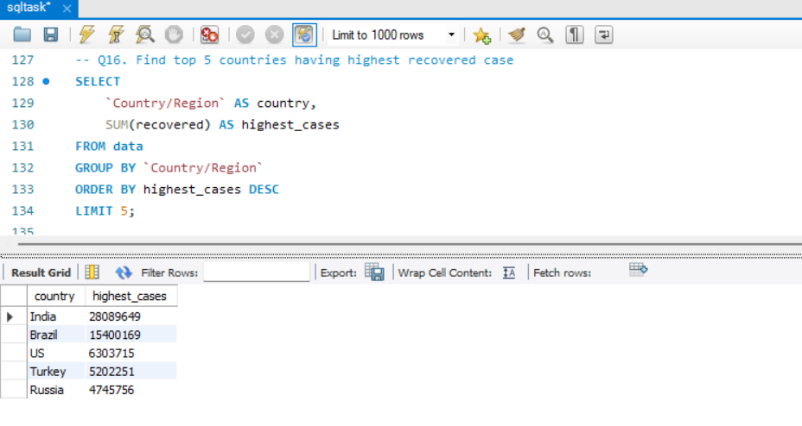
16. Find top 5 countries having highest recovered case
ksjdgblsgd

Slide 19
Thank You!

